Slide 1

UNIX Workshop: Practical Guide to the Command Line
AAFC Bioinformatics Conference and Workshop
September 19-20, 2019, Lethbridge, Alberta
Miles Buchwaldt
Biology Study Leader – Bioinformatics, Saskatoon RDC
19 Sept. 2019

Slide 2
The Goal of this Workshop
Introduce the fundamental concepts of working in UNIX environments
Beginners will acquire the basics and some exposure to UNIX
Experienced users might learn a trick or two
Independent study and practice will be required to become effective
https://redmine.biodiversity.agr.gc.ca/projects/biocluster/wiki/Biocluster_User_Guide

Slide 3
Table of Contents
1. Basic Commands
2. Input & Output
3. The Environment
4. Non-standard Software
5. Regular Expressions
6. Scripting

Slide 4
Initial Setup
Create a secure shell on the remote server:
$ ssh <username>@<address>
Acquire access to a worker node:
$ qlogin -n 1
Run a script to setup the workshop environment:
$ ./workshop_setup.sh

Slide 6
What is the command line?
User interface, where a user can issues “commands” to the computer carry out various tasks.
Commands follow a strict format:
$ <command> <options> <arguments>
<command>: an executable file on the system
<options>: flags that change the default behavior of the program
<arguments>: information the program requires to carry out it’s task

Slide 7
Locating Files and Directories
Where am I?
$ pwd
What is around me?
$ ls
How do I leave this place?
$ cd

Slide 8
Paths – Relative vs Absolute
Relative path: specifies the path from your current location to the file
Absolute path: specifies the path to the file relative to the base root directory, /

Slide 9
Create, Move, Delete Files
Creating files:
$ touch
Copying/Moving files:
$ cp
$ mv
Deleting files:
$ rm

Slide 10
Reading File Contents
Print a file:
$ cat
Print the top/bottom of a file:
$ head
$ tail
View paginated version:
$ less

Slide 11
Options
Alter the behavior of commands
Find appropriate options via the manual pages
$ man <command>

Slide 12

Input and Output
Text Streams
Redirection
Pipes

Slide 13
Text Streams
Text streams are blocks of characters, usually separated by newlines.
They are NOT the same thing as text files
Examples: STDIN, STDOUT, STDERR
Most commands take input from STDERR, output to STDOUT and if there are errors, send error information to STDERR
Notes:
Fundamentally, everything in UNIX operates on text

Slide 14
Redirection
These three text streams can be redirected (most often using files)
Redirect STDIN (read from file)
$ cat < text.txt
Redirect STDOUT
$ cat text.txt > another_text.txt
Redirect STDERR (and append
$ cat text.txt 2>> errors_text.txt

Slide 15
Pipes
Redirect the STDOUT of one command to the STDIN of another command
Useful to chain multiple commands together.
$ ls | wc -l
$
* wc “Word Count” counts pieces of a file (-l specifies to count lines)
count the number of files in the current directory
Notes:
Pipes are what give UNIX systems it’s power. The possibilities are only limited by the user’s creativity and knowledge of available commands.

Slide 16

The Environment
Do you think those are buttons you are clicking? Do you honestly think that your mouse has any effect on your commands, in here?
Variables
Permissions
Important Directories

Slide 17
Where do commands go?
The “interpreter”, sh, bash, perl, python
Variables:
$PATH, $HOME, $USER
Print a variable’s contents with:
$ echo <$VARIABLE>
Set a variable with:
$ export VARIABLENAME=”New value”
*$ export PATH=$PATH:/path/to/new/software*

Slide 18
Variables
Some software has prerequisite packages, libraries, modules.
These are found using variables containing the path to the required files:
$LDFLAGS
$CPPFLAGS
To get a list of the current variables:
$ printenv

Slide 19
Environment Setup
~/.bashrc, ~/.bash_profile
Edit these files with a text editor
Must restart shell session, or source the files before changes come into effect:
$ source ~/.bash_profile
$ . ~/.bashrc

Slide 20

Software
READ THE DOCUMENTATION! You can usually find it in INSTALL.txt, README.*, the GitHub page, the wiki, or with a google search.
Installation
Execution
Troubleshooting

Slide 21
Installing New Programs (via git)
Download a git repository
$ git clone https://github.com/lh3/bwa.git
Look out for special instructions that pertain to you
Likely a local installation!
./configure --prefix=~/bin

Slide 22
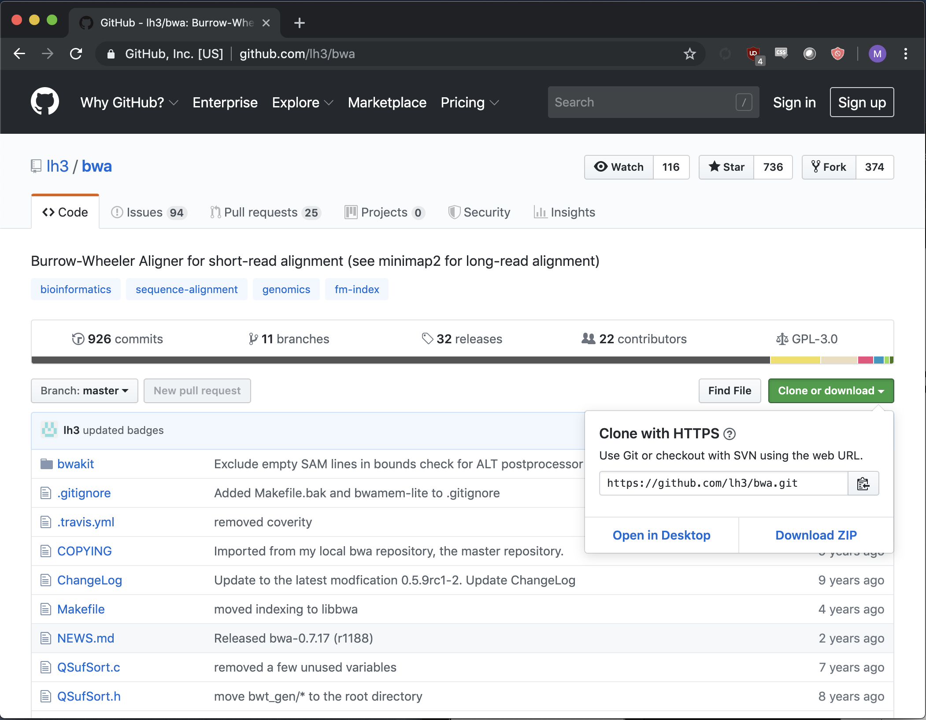
To get github link:
CLICK THIS

Slide 23
Make and Makefiles
./configure [--prefix=~/bin]
make
make install
Look out for errors in the above and Read Them
Most likely causes for compilation errors are missing or incorrect version of dependencies.

Slide 24
Add To Path
To use a new command without specifying the relative/absolute path to it each time:
$ export PATH=$PATH:/path/to/command
Or add to ~/.bash_profile or ~/.bashrc
$ source ~/.bash_profile
$ which command

Slide 25

Dependencies
Instructions for software requirements usually come before installation instructions.
Make sure this software is installed
Some dependencies will require administrative priviledges (superuser)
Libraries, compiler versions,
Some dependencies can be installed by the user as long as the required version is specified in environment variables.

Slide 26
Running Software
Read Documentation: README.txt, README.md, etc.
$ <command> <options> <arguments>
$ java -jar /path/to/software.jar <options> <arguments>
$ perl script.pl <options> <arguments>
$
Make sure you understand what the command will do before you press enter!

Slide 27
Monitoring Jobs
top, PID, ps, kill,

Slide 28
Regular Expressions (shell)
Wildcards
Loops

Slide 29
Wildcards
Wildcards are special characters that have special meaning to the interpreter

Slide 31
Shell Scripts
Variables
Conditionals
Loops

Slide 32
Variables
Store data

Slide 33
Conditionals
Run a code segment only if a condition is satisfied
Useful for specific tasks, and also to avoid error states

Slide 34
Loops
Run a code segment multiple times
Common pitfalls:
Infinite loops
Off-by-one errors
Different types:
For loops
While loops
Recursion (too complicated for this workshop and rarely required)

Slide 35
Scripts
Interpreter
Syntax

Slide 36
Scripts
Are “interpreted” sets of instructions to control other programs
Notes:
Interpreted -> not compiled

